Slide 1
















Voice-Based Form Filling: Automating Accessibility
By Harini P

Slide 2

Filling Forms – A Tedious Task?
Manual form-filling is time-consuming and error-prone.
Individuals with physical disabilities face accessibility challenges.
Need for automation and a user-friendly solution.
Cyber crime – Keyloggers issues

Slide 3
01.
Voice Recognition: Use of speech-to-text technology.
Voice-Based Form Filling: The Technical Solution
Backend Logic: Flask-based server that handles form submission and validation.
02.
03.
Database Integration: MySQL for storing user data and form entries.
04.
Security Measures: Password hashing and secure
communication.

Slide 4
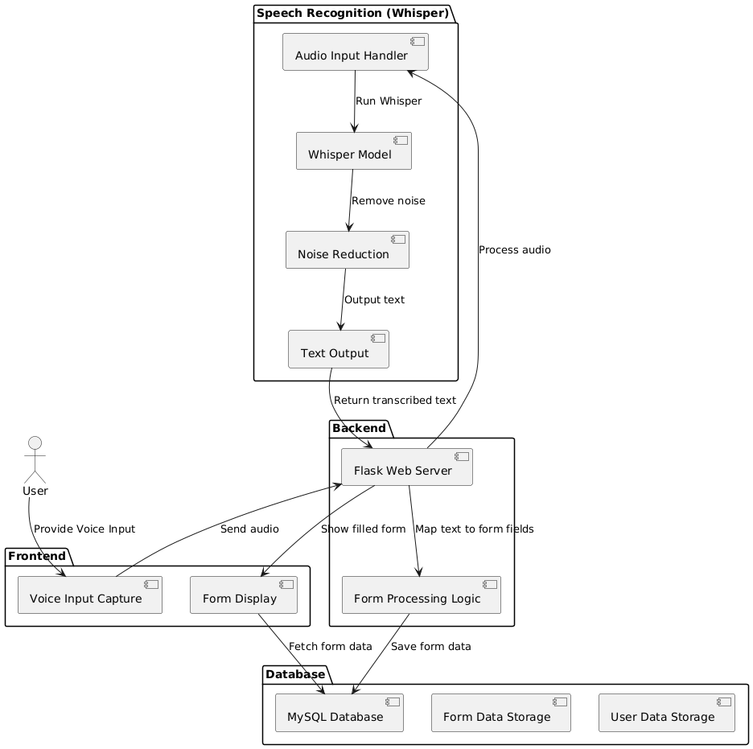
System Architecture–
The Building Blocks

Slide 5
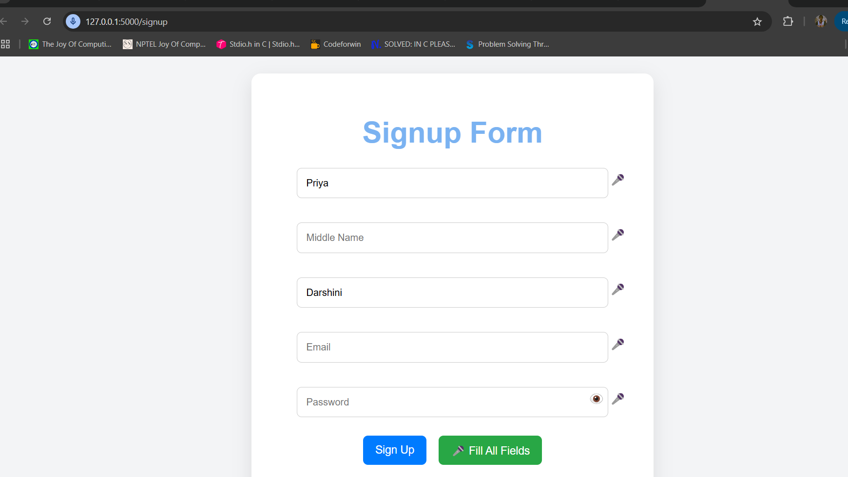
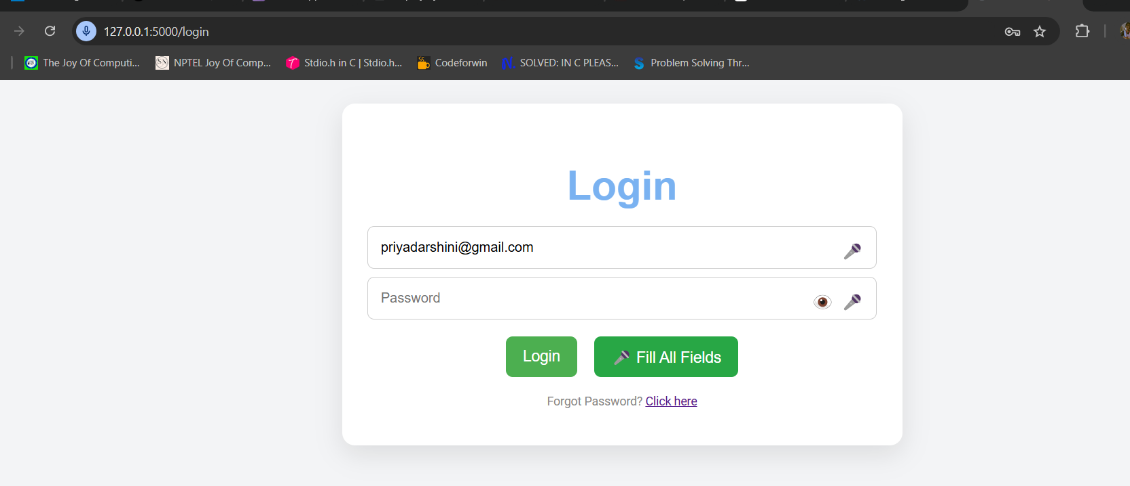

Slide 6
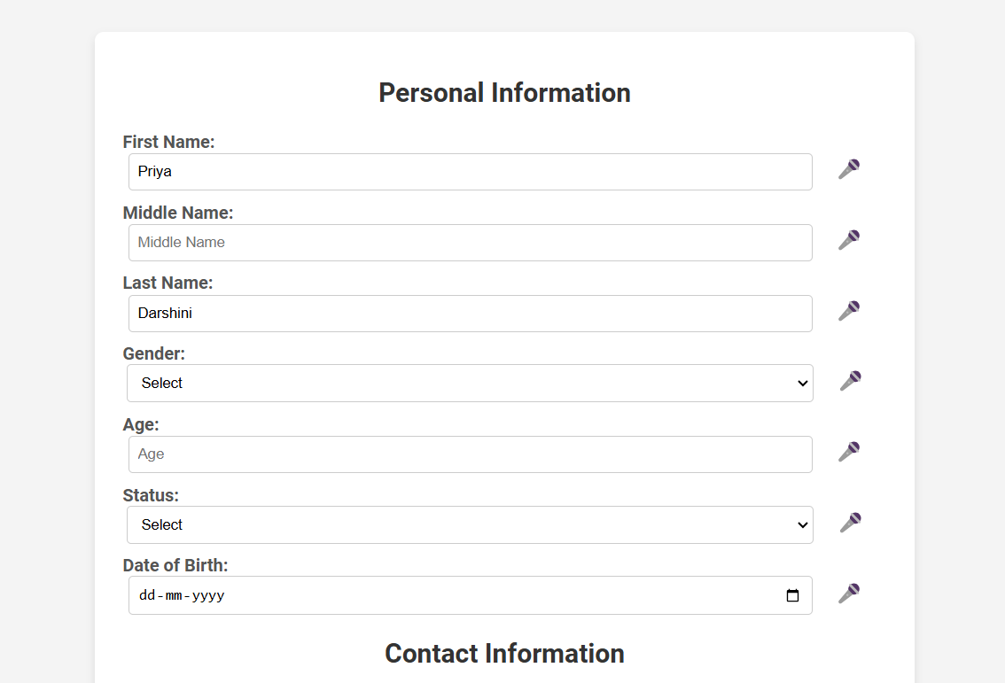
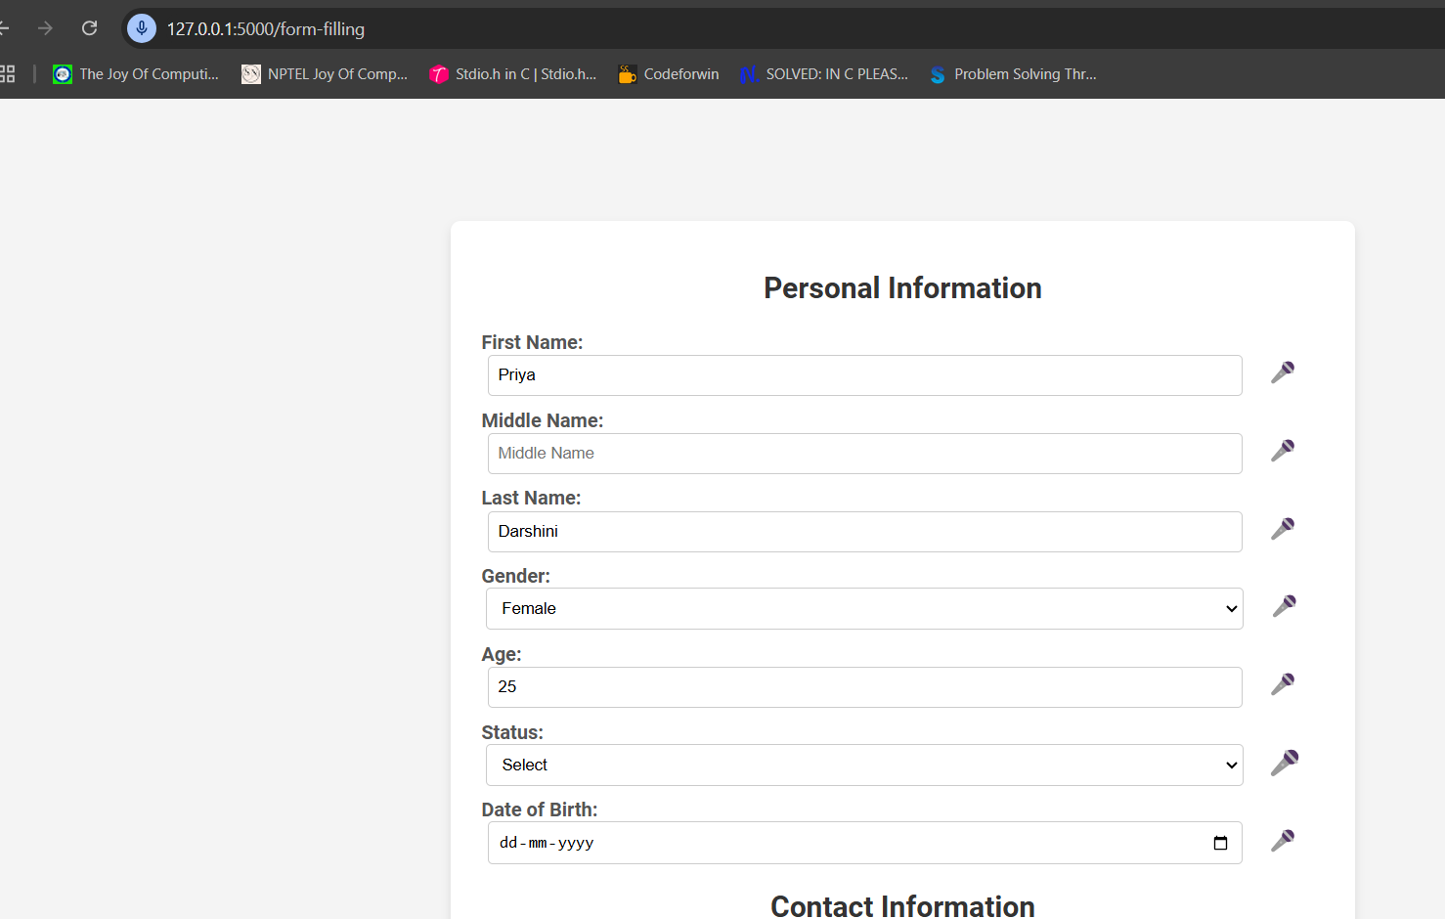
P
Prefilled details from database

Slide 7

v
Future Enhancements
Multilingual Support: Cater to global users.
AI-Powered Accuracy: Improved speech-to-text results.
Offline Mode: Functionality without internet.
Dynamic Fields: Handle complex forms based on user’s input.

Slide 8
Deployment Part
Deployment is done using ‘Render Website’
Link Form filling project

Slide 9
Thank you very much!

